Slide 1
Global Economic Shifts ECON 220
Trade, Technology and Economic Integration: The Ricardian Model
Instructor: Muhebullah Karimzada
Notes:
If this PowerPoint presentation contains mathematical equations, you may need to check that your computer has the following installed:
1) MathType Plugin
2) Math Player (free versions available)
3) NVDA Reader (free versions available)

Slide 2
Questions to Consider
What are reasons for countries to trade?
Will the country that is best at producing a good always export it?
How can countries compete with low-wage exporters, like China?

Slide 3
Introduction
Reasons countries trade goods with each other
Differences in the technology used in each country (i.e., differences in each country’s ability to manufacture products)
Differences in the total amount of resources (including labor, capital, and land) found in each country
Differences in the costs of offshoring (i.e., producing the various parts of a good in different countries and then assembling them into the finished product in a final location)
The proximity of countries to each other (i.e., how close they are to one another). The closer countries are, the lower the costs of transportation.

Slide 4
Introduction Cont’d
In this lecture, we focus on technology differences across countries as an explanation for trade, called the Ricardian model.
The Ricardian model explains how the level of a country’s technology affects its trade pattern.
It also explains the concept of comparative advantage and why it works as an explanation for trade patterns.

Slide 5
1) Reasons for Trade
Proximity
The closer countries are, the lower the costs of transportation. For example, the largest trading partner of many European countries is another European country.
Resources
Geography includes natural resources, as well as labor resources and capital. A country’s resources are often collectively called its factors of production, the land, labor, and capital used to produce goods and services.

Slide 6
1) Reasons for Trade Cont’d
Absolute Advantage
When a country has the best technology for producing a good, it has an absolute advantage in the production of that good.
Absolute advantage is not a good explanation for trade patterns.
Comparative Advantage
Instead, comparative advantage is the primary explanation for trade among countries.
A country has comparative advantage in producing those goods that it produces best compared with how well it produces other goods.

Slide 7
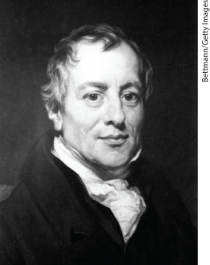
David Ricardo and Mercantilism
Mercantilists believed that exporting was good because it generated gold and importing was bad because it drained gold from the national treasury.
Mercantilists were in favor of high tariffs to ensure high exports and low imports.
Ricardo showed that countries could benefit from international trade without having to use tariffs.
Many of today’s major international institutions around the world were founded at least in part on the idea that free trade between countries brings gains for all trading partners.

Slide 8
2) Ricardian Model of Trade (part 1)
The Home Country
To develop a Ricardian model of trade, we will use an example with two goods:
Wheat and other grains are major exports of the United States and Europe.
Many types of cloth are imported into these countries.
For simplicity, we will ignore the role of land and capital and suppose that both goods are produced with labor alone.

Slide 9
2) Ricardian Model of Trade (part 2)
The Home Country
We assume that labor is the only resource used to produce goods. The marginal product of labor (MPL) is the extra output obtained by using one more unit of labor.
In Home, one worker produces 4 bushels of wheat, so MPL_{W} = 4.
Alternatively, one worker can produce 2 yards of cloth, so MPL_{C} = 2.

Slide 10
2) Ricardian Model of Trade (part 3)
The Home Country
Home Production Possibilities Frontier
We can graph Home’s production possibilities frontier (PPF) using the marginal products for wheat and cloth.
The slope of the PPF is also the opportunity cost of wheat, the amount of cloth that must be given up to obtain one more unit of wheat.
If Home had 25 workers and all were employed in wheat, Home could produce 100 bushels. If all were employed in cloth, they could produce 50 yards.

Slide 11
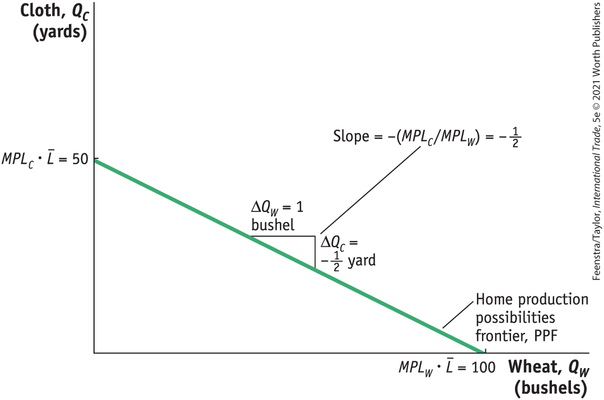

2) Ricardian Model of Trade (part 4)
The Home Country
Home Production Possibilities Frontier
The Home PPF is a straight line between 50 yards of cloth and 100 bushels of wheat.
The slope of the PPF equals the negative of the opportunity cost of wheat. Equivalently, the magnitude of the slope can be expressed as the ratio of the marginal products of labor for the two goods.
FIGURE 2-1
$$Slope of PPF=−\frac{50}{100}=−\frac{MPL_{C}∙\overline{L}}{MPL_{W}∙\overset{̿}{L}}=−\frac{MPL_{C}}{MPL_{W}}=−\frac{1}{2}$$

Slide 12
2) Ricardian Model of Trade (part 5)
The Home Country
Home Indifference Curve
We will represent demand in the home economy using indifference curves that have the following properties:
All points on an indifference curve have the same level of utility.
Points on higher indifference curves have higher utility.
Each indifference curve shows the combinations of two goods, such as wheat and cloth, that a person or economy can consume and be equally satisfied.

Slide 13
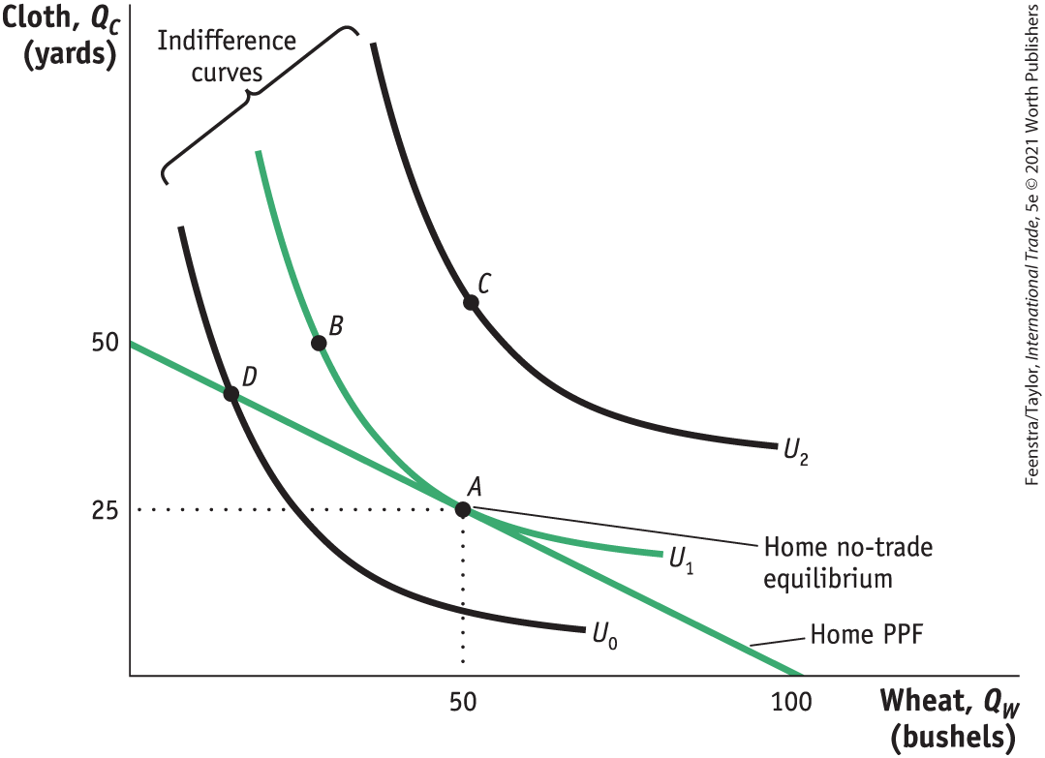
2) Ricardian Model of Trade (part 6)
FIGURE 2-2
The Home Country
Home Indifference Curve
Points A and B lie on the same indifference curve and give the Home consumers the level of utility U1.
The highest level of Home utility on the PPF is obtained at point A, which is the no-trade equilibrium.
Point D is also on the PPF but would give lower utility.
Point C represents a higher utility level but is off of the PPF, so it is not attainable in the absence of international trade.
Home Equilibrium with No Trade

Slide 14
2) Ricardian Model of Trade (part 7)
The Home Country
Home Equilibrium
In the absence of international trade, the production possibilities frontier acts like a budget constraint for the country, and with perfectly competitive markets, the economy will produce at the point of highest utility subject to the limits imposed by its PPF.
The point of highest utility is at point A in Figure 2-2, where Home consumes 25 yards of cloth and 50 bushels of wheat.
We will refer to point A as the “no-trade” or the “pre-trade” equilibrium for Home.

Slide 15
2) Ricardian Model of Trade (part 8)
The Home Country
Opportunity Cost and Prices
The slope of the PPF reflects the opportunity cost of producing one more bushel of wheat.
Under perfect competition the opportunity cost of wheat should also equal the relative price of wheat.
Price reflects the opportunity cost of a good.

Slide 16
2) Ricardian Model of Trade (part 9)
The Home Country
Wages
In competitive markets, firms hire workers up to the point at which the hourly wage equals the value of one more hour of production.
The value of one more hour of labor equals the amount of goods produced in that hour (MPL) times the price of the good.
Labor will be hired up to the point where wage equals P x MPL for each industry.

Slide 17
2) Ricardian Model of Trade (part 10)
The Home Country
Wages
Use the equality of the wage across industries to obtain the following equation:
P_{W} • MPL_{W} = P_{C} • MPL_{C}
Rearranging terms, we see that
P_{W} /P_{C} = MPL_{C} /MPL_{W}
The right-hand side of the equation is the slope of the production possibilities frontier (the opportunity cost of one more bushel of wheat).
The left-hand side of the equation is the relative price of wheat.

Slide 18
2) Ricardian Model of Trade (part 11)
The Foreign Country
Assume a Foreign worker can produce 1 bushel of wheat or 1 yard of cloth.
MPL*_{W} = 1, MPL*_{C} = 1
Assume there are 100 workers available in Foreign.
If all workers were employed in wheat, they could produce 100 bushels.
If all workers were employed in cloth, they could produce 100 yards.
It is worth noting that Home has absolute advantage in both goods but will export only one, as explained later.

Slide 19
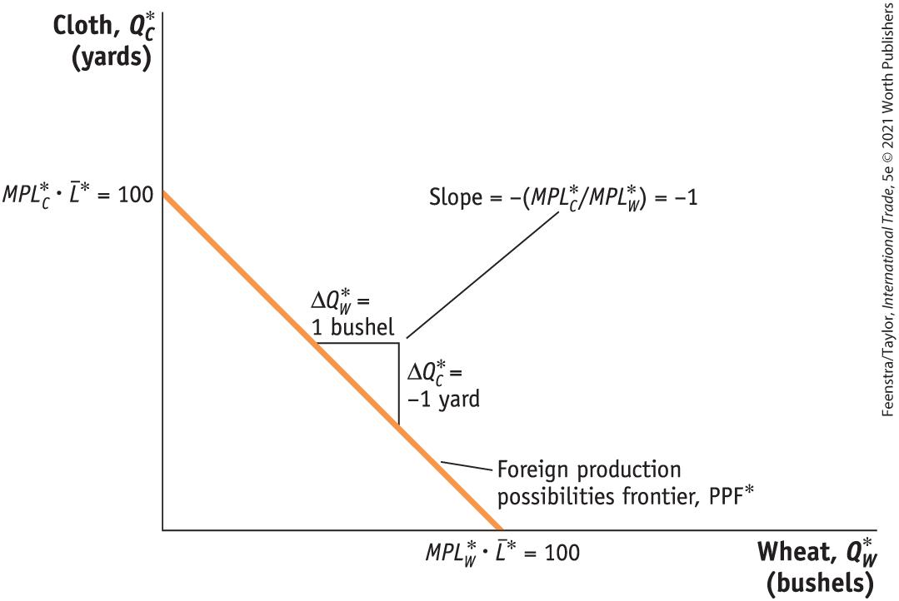
2) Ricardian Model of Trade (part 12)
The Foreign Country
The Foreign Production Possibilities Frontier
The Foreign PPF is a straight line between 100 yards of cloth and 100 bushels of wheat.
The slope of the PPF equals the negative of the opportunity cost of wheat.
The opportunity cost is the amount of cloth that must be given up (1 yard) to obtain 1 more bushel of wheat.
FIGURE 2-3

Slide 20
2) Ricardian Model of Trade (part 13)
The Foreign Country
Comparative Advantage
A country has a comparative advantage in a good when it has a lower opportunity cost of producing than another country.
By looking at the chart we can see that Foreign has a comparative advantage in producing cloth. Home has a comparative advantage in producing wheat.
 | Cloth (1 Yard) | Wheat (1 Bushel)
Home | 2 Bushels of Wheat | ½ Yard of Cloth
Foreign | 1 Bushel of Wheat | 1 Yard of Cloth

Slide 21
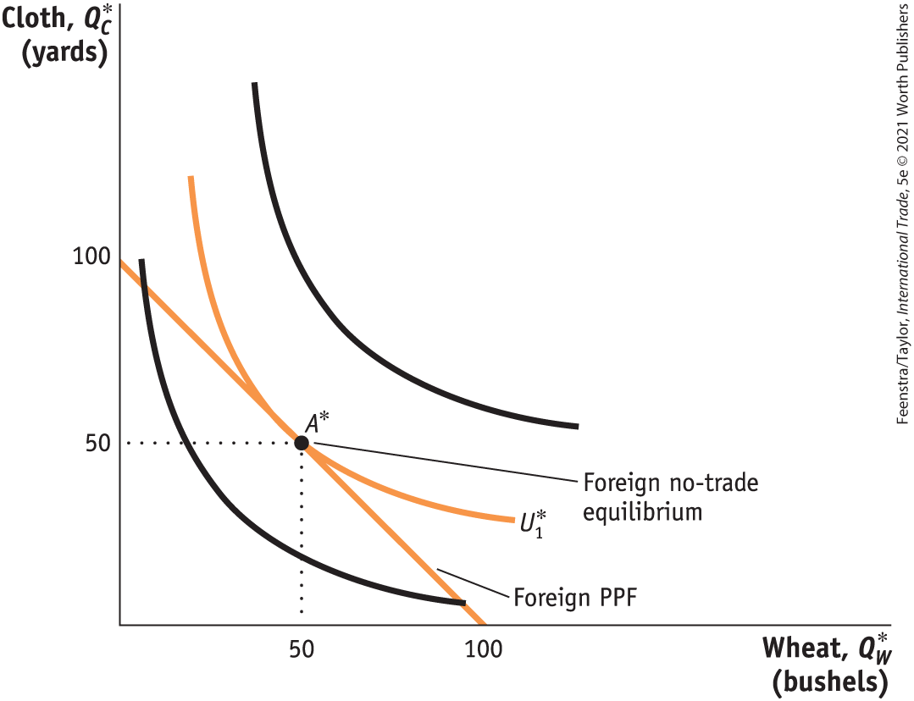
2) Ricardian Model of Trade (part 14)
The Foreign Country
Comparative Advantage
The highest level of Foreign utility on the PPF is obtained at point A*, which is the no-trade equilibrium.
FIGURE 2-4
Foreign Equilibrium with No Trade

Slide 22
3) Determining the Pattern of International Trade (part 1)
International Trade Equilibrium
What happens when goods are traded between Home and Foreign? We will see:
That a country’s no-trade relative price determines which product it will export and which it will import
The no-trade relative price equals its opportunity cost of production
The pattern of exports and imports will be determined by the opportunity costs of production in each country—their comparative advantage

Slide 23
3) Determining the Pattern of International Trade (part 2)
International Trade Equilibrium
Examining each country’s no-trade relative price, we can determine which product it will export and which it will import.
The relative price of cloth in Foreign is P_{C} /P_{W} = 1.
The relative price of cloth in Home is P_{C} /P_{W} = 2.
Therefore, Foreign would want to export cloth to Home if they can make it for $1 and export it for more than $1.
Home will export wheat, and Foreign will export cloth.
Both countries export the good for which they have the comparative advantage.

Slide 24
3) Determining the Pattern of International Trade (part 3)
International Trade Equilibrium
The two countries are in an international trade equilibrium when the relative price of wheat is the same in the two countries.
To fully understand the international trade equilibrium, we are interested in two issues:
Determining the relative price of wheat (or cloth) in the trade equilibrium
Seeing how the shift from the no-trade equilibrium to the trade equilibrium affects production and consumption in both Home and Foreign

Slide 25
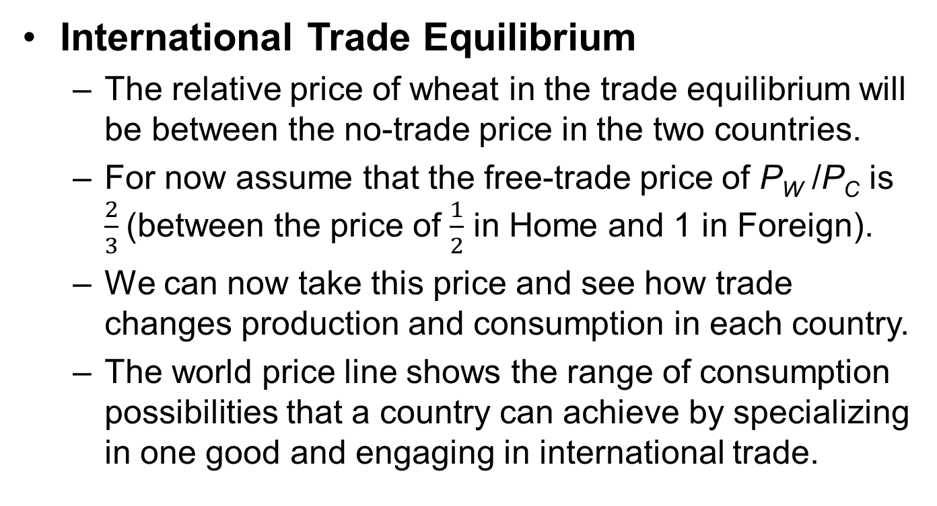
3) Determining the Pattern of International Trade (part 4)
International Trade Equilibrium
The relative price of wheat in the trade equilibrium will be between the no-trade price in the two countries.
For now assume that the free-trade price of P_{W} /P_{C} is $\frac{2}{3}$(between the price of $\frac{1}{2}$ in Home and 1 in Foreign).
We can now take this price and see how trade changes production and consumption in each country.
The world price line shows the range of consumption possibilities that a country can achieve by specializing in one good and engaging in international trade.

Slide 26
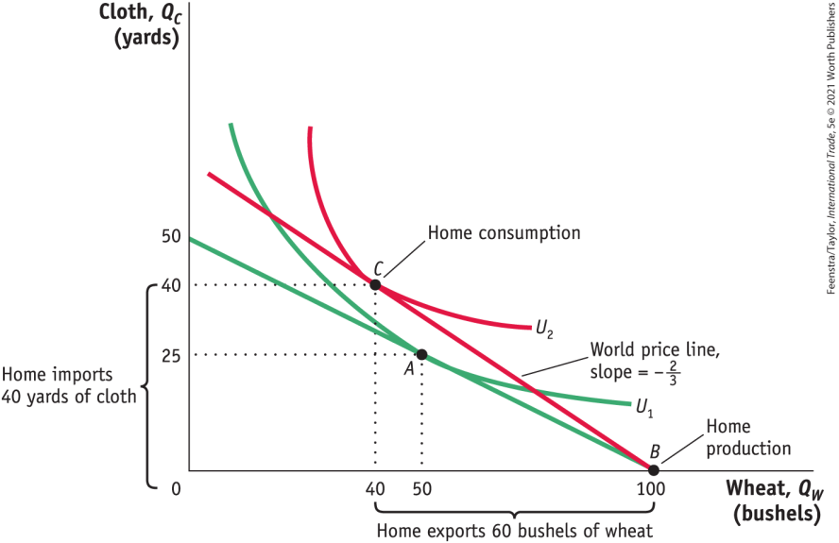
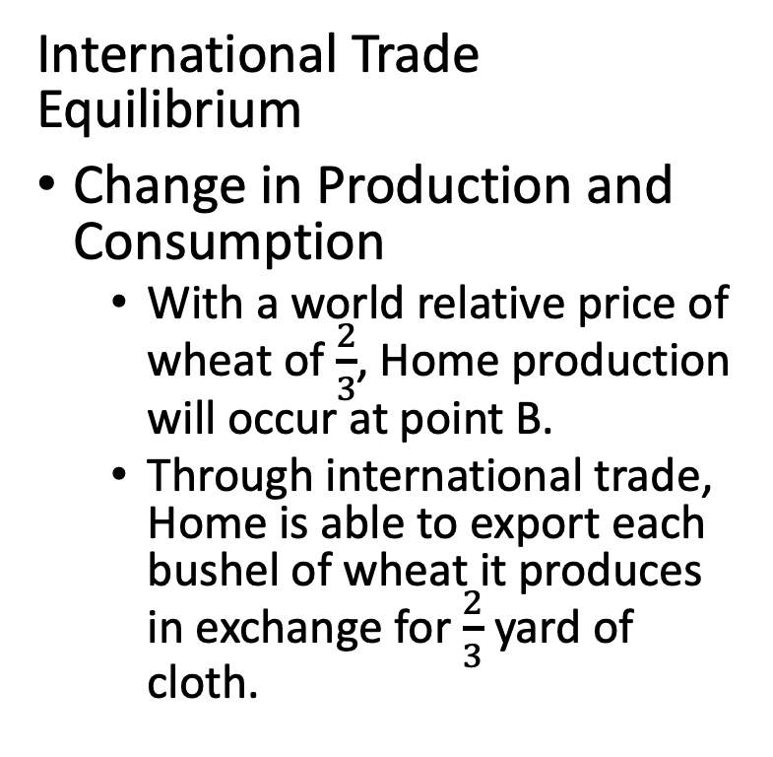
3) Determining the Pattern of International Trade (part 5)
International Trade Equilibrium
Change in Production and Consumption
With a world relative price of wheat of $\frac{2}{3}$, Home production will occur at point B.
Through international trade, Home is able to export each bushel of wheat it produces in exchange for $\frac{2}{3}$ yard of cloth.
FIGURE 2-5 (1 of 3)
Home Equilibrium with Trade

Slide 27
3) Determining the Pattern of International Trade (part 6)
FIGURE 2-5 (2 of 3)
International Trade Equilibrium
Change in Production and Consumption
As wheat is exported, Home moves up the world price line BC. Home consumption occurs at point C, at the tangent intersection with indifference curve U₂, since this is the highest possible utility curve on the world price line.
Home Equilibrium with Trade

Slide 28
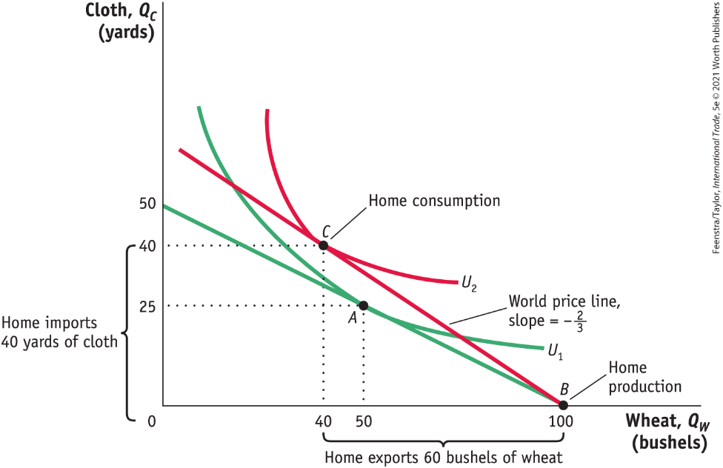
3) Determining the Pattern of International Trade (part 7)
FIGURE 2-5 (3 of 3)
International Trade Equilibrium
Change in Production and Consumption
Given these levels of production and consumption, we can see that total exports are 60 bushels of wheat in exchange for imports of 40 yards of cloth and also that Home consumes 10 fewer bushels of wheat and 15 more yards of cloth relative to its pre-trade levels.
Home Equilibrium with Trade

Slide 29
3) Determining the Pattern of International Trade (part 8)
FIGURE 2-5 (revisited)
International Trade Equilibrium
International Trade
Home obtains a higher utility with international trade than in the absence of trade (U₂ is higher than U₁).
The finding that Home’s utility increases with trade is our first demonstration of the gains from trade.
Home Equilibrium with Trade

Slide 30
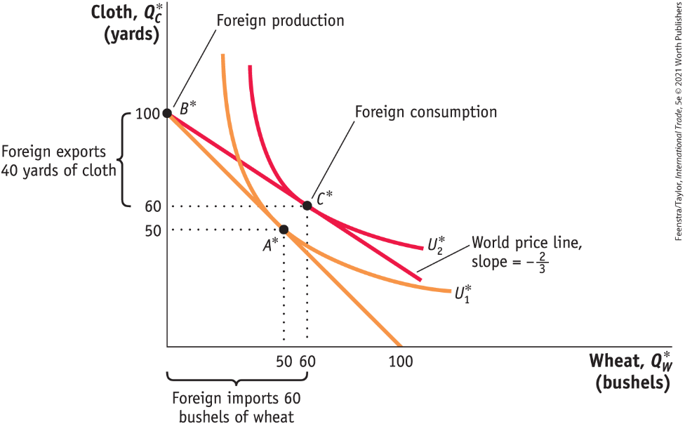
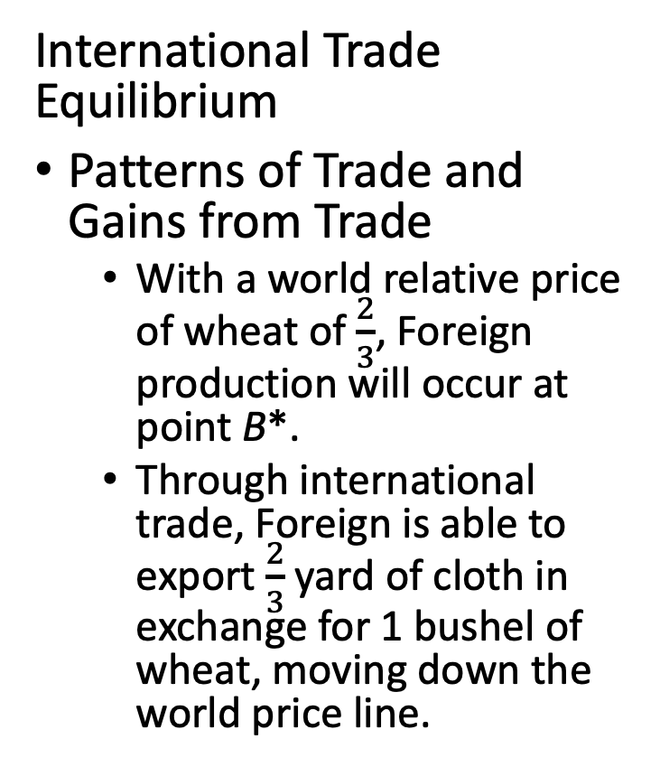
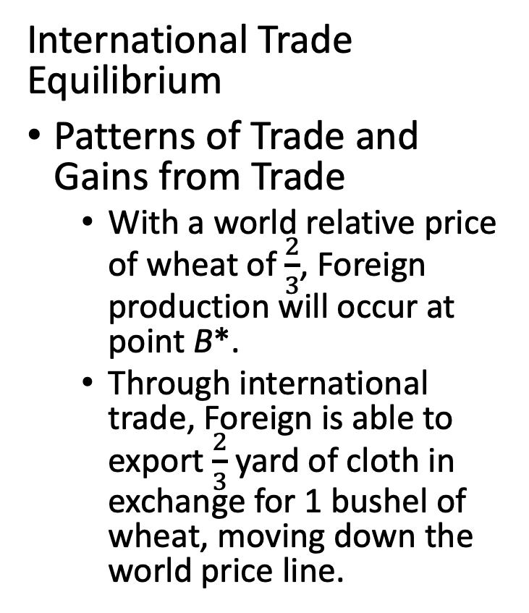
3) Determining the Pattern of International Trade (part 9)
FIGURE 2-6 (1 of 2)
International Trade Equilibrium
Patterns of Trade and Gains from Trade
With a world relative price of wheat of $\frac{2}{3}$, Foreign production will occur at point B*.
Through international trade, Foreign is able to export $\frac{2}{3}$ yard of cloth in exchange for 1 bushel of wheat, moving down the world price line.
Foreign Equilibrium with Trade
International Trade Equilibrium
Patterns of Trade and Gains from Trade
With a world relative price of wheat of $\frac{2}{3}$, Foreign production will occur at point B*.
Through international trade, Foreign is able to export $\frac{2}{3}$ yard of cloth in exchange for 1 bushel of wheat, moving down the world price line.

Slide 31
3) Determining the Pattern of International Trade (part 10)
FIGURE 2-6 (2 of 2)
International Trade Equilibrium
Patterns of Trade and Gains from Trade
Foreign consumption occurs at point C*, and total exports are 40 yards of cloth in exchange for imports of 60 bushels of wheat. Relative to its pre-trade wheat and cloth consumption (point A*), Foreign consumes 10 more bushels of wheat and 10 more yards of cloth.
Foreign Equilibrium with Trade

Slide 32
3) Determining the Pattern of International Trade (part 11)
International Trade Equilibrium
Patterns of Trade and Gains from Trade
Each country is exporting the good for which it has the comparative advantage.
This confirms that the pattern of trade is determined by comparative advantage.
This is the first lesson of the Ricardian model.
There are gains from trade for both countries.
This is the second lesson of the Ricardian model.

Slide 33
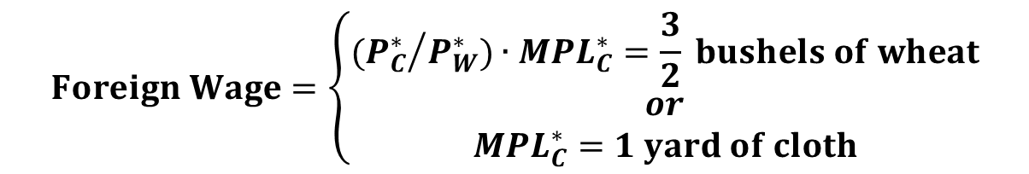

3) Determining the Pattern of International Trade (part 12)
Solving for Wages Across Countries
Home Wage = $\left\{\begin{aligned}{MPL}_{w}=4 bushels of wheat \\ or \\ \left({P_{w}}/{P_{c}}\right).{MPL}_{w}= \frac{8}{3} yard of cloth\end{aligned}\right.$
$$Foreign Wage=\left\{\begin{aligned}({P_{C}^{∗}}/{P_{W}^{∗})∙MPL_{C}^{∗}=\frac{3}{2} bushels of wheat} \\ or \\ MPL_{C}^{∗}=1 yard of cloth\end{aligned}\right.$$
Absolute Advantage
As our example shows, wages are determined by absolute advantage. In contrast, the pattern of trade in the Ricardian model is determined by comparative advantage.

Slide 34
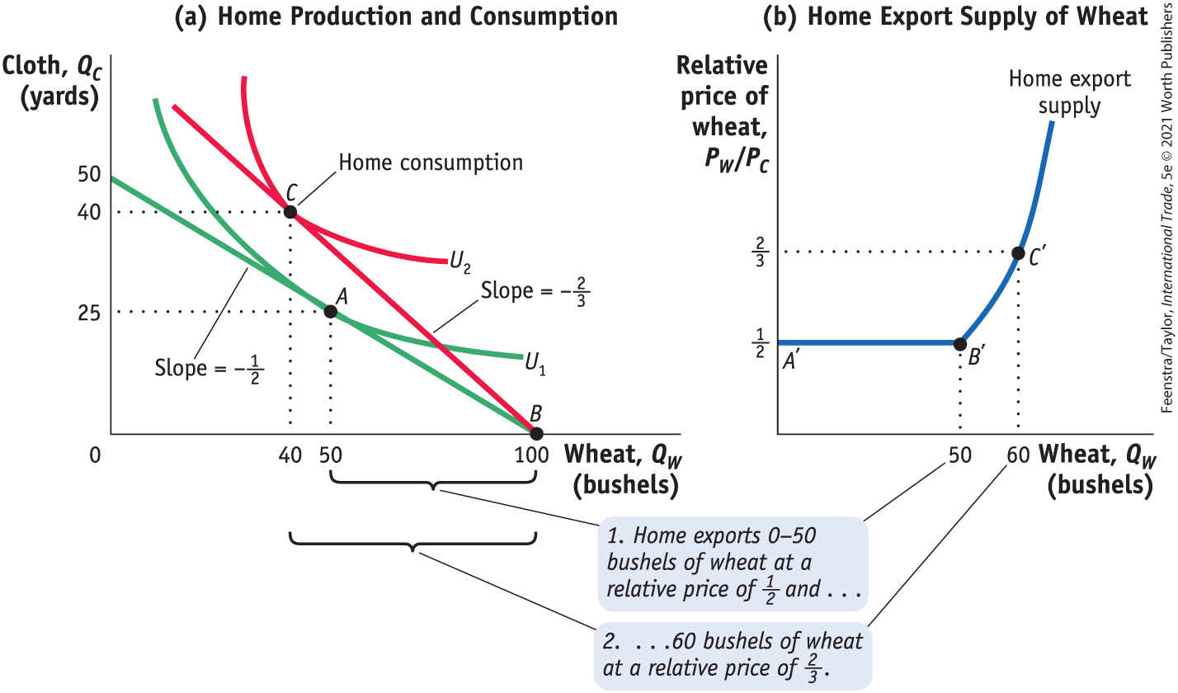
4) Solving for International Prices (part 1)
Home Export Supply Curve
Home Export Supply Panel (a) repeats Figure 2-5, showing the trade equilibrium for Home with production at point B and consumption at point C. Panel (b) shows the home export supply of wheat.
FIGURE 2-10 (1 of 2)

Slide 35
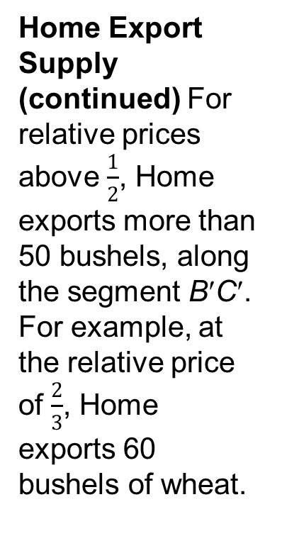
4) Solving for International Prices (part 2)
Home Export Supply Curve
Home Export Supply (continued) For relative prices above $\frac{1}{2}$, Home exports more than 50 bushels, along the segment B′C′. For example, at the relative price of $\frac{2}{3}$, Home exports 60 bushels of wheat.
FIGURE 2-10 (2 of 2)

Slide 36
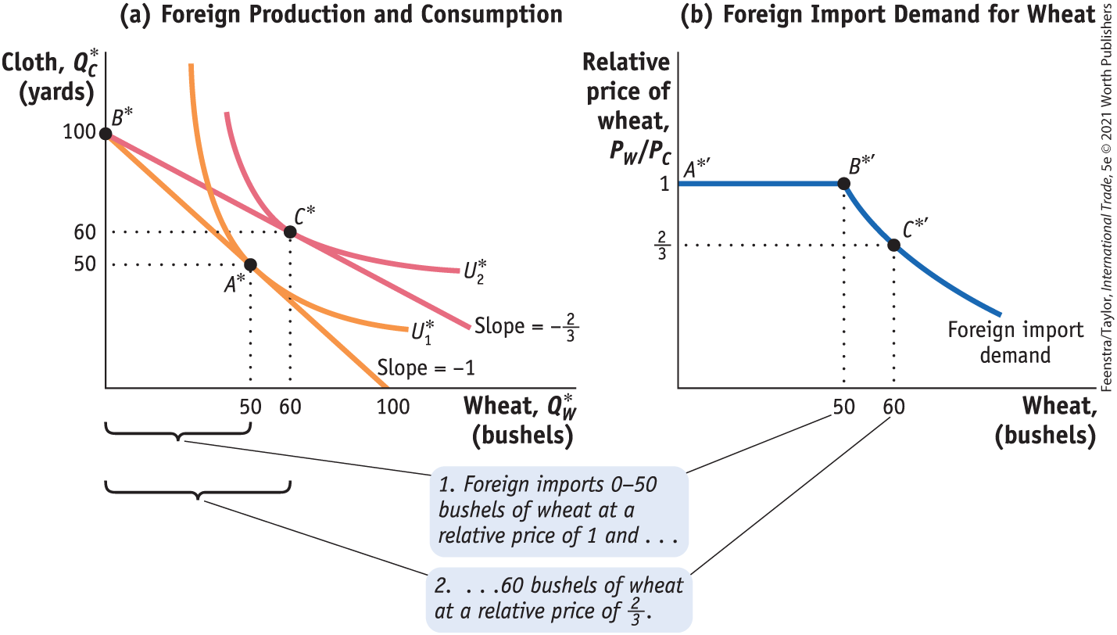
4) Solving for International Prices (part 3)
Foreign Import Demand Curve
Foreign Import Demand Panel (a) repeats Figure 2-6. Panel (b) shows foreign import demand for wheat. When the relative price of wheat is 1, Foreign will import any amount of wheat between 0 and 50 bushels, along the segment A*' B*' of the foreign import demand curve.
FIGURE 2-11 (1 of 2)

Slide 37
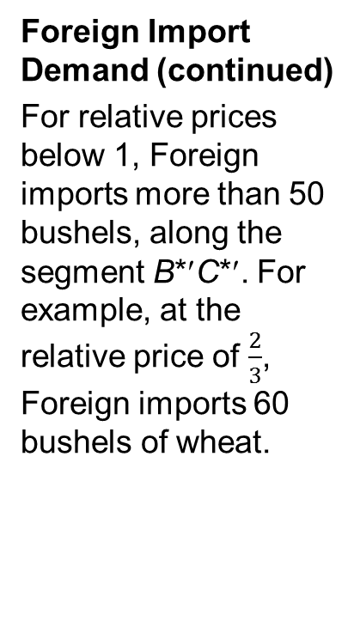
4) Solving for International Prices (part 4)
Foreign Import Demand Curve
Foreign Import Demand (continued)
For relative prices below 1, Foreign imports more than 50 bushels, along the segment B*′C*′. For example, at the relative price of $\frac{2}{3}$, Foreign imports 60 bushels of wheat.
FIGURE 2-11 (2 of 2)

Slide 38
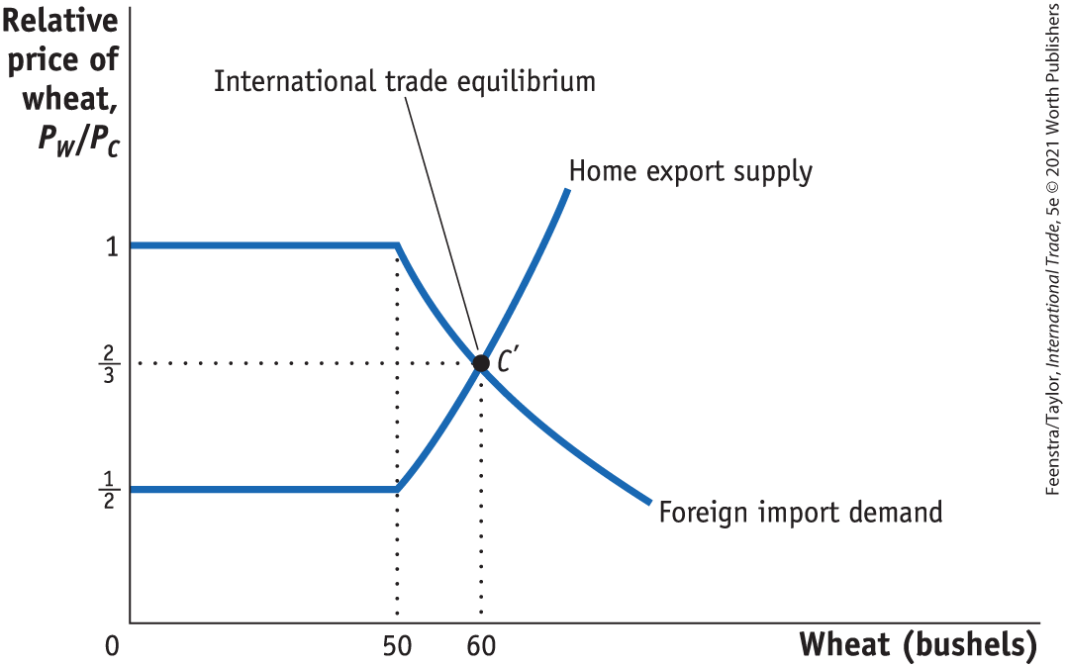
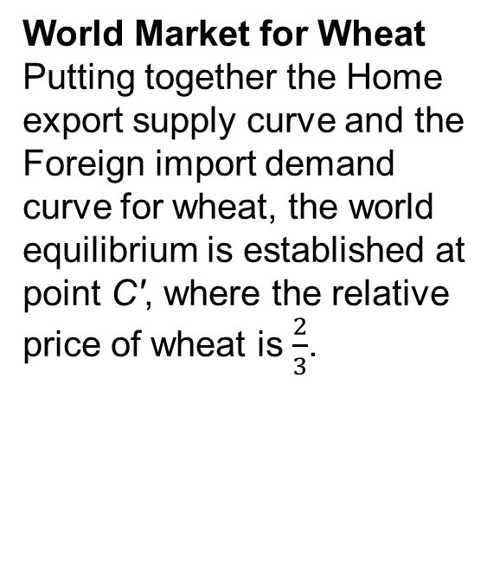
4) Solving for International Prices (part 5)
International Trade Equilibrium
FIGURE 2-12
World Market for Wheat Putting together the Home export supply curve and the Foreign import demand curve for wheat, the world equilibrium is established at point C', where the relative price of wheat is $\frac{2}{3}$.

Slide 39
4) Solving for International Prices (part 6)
International Trade Equilibrium
The Terms of Trade
The price of a country’s exports divided by the price of its imports is called the terms of trade.
Because Home exports wheat, (P_{W}/P_{C}) is its terms of trade.
Foreign exports cloth, so (P_{C} /P_{W}) is its terms of trade.
In this case, having a higher price for cloth (Foreign’s export) or a lower price for wheat (Foreign’s import) would make the foreign country better off.

Slide 40
Conclusions
The Ricardian model was developed as a response to the mercantilist idea that exports are good and imports are bad.
Using differences in technology and opportunity cost, Ricardo demonstrated that the pattern of trade is determined by comparative advantage and that both countries gain from trade.
Wages depend on the marginal products of labor in each country and are determined by absolute advantage: a country with better technology will be able to pay higher wages.
The fact that only labor is used in the Ricardian model, with a constant marginal product of labor, makes it special. The PPF is a straight line, and the export supply and import demand curves each have a flat segment.

Slide 41
Discovering Data
In this chapter we explored the concept of comparative advantage as the basis for trade in the Ricardian model. Go to the online UNCTad database https://unctadstat.unctad.org/EN/RcaRadar.html and choose two countries that are neighbors, for example, Canada and the United States.
Which goods does each country have the greatest comparative advantage in? Choose three (3).
Now go to the Observatory of Economic Complexity https://oec.world/en/profile/bilateral-country/can/partner/usa and look at the bilateral trade data for the countries you chose.
Does the trade pattern between the two countries reflect the comparative advantage you found? Why or why not?

